Slide 1
BASIC OF APPLICATION LAYER
Presenter: Nguyễn Hải Đăng

Slide 2
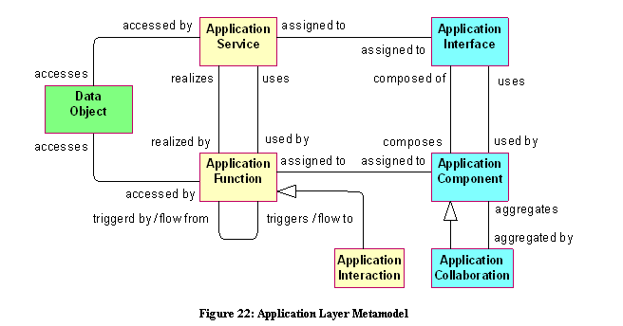
BASIC OF APPLICATION LAYER

Slide 3
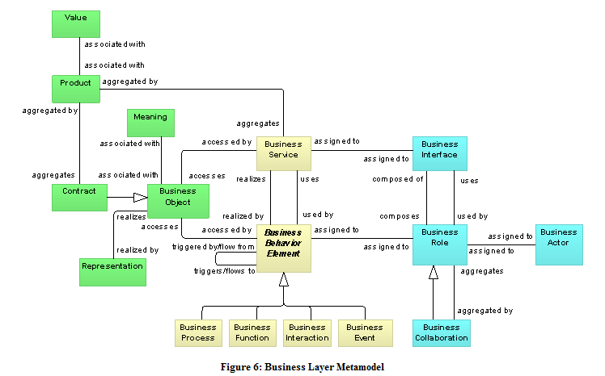
BASIC OF APPLICATION LAYER

Slide 4
2 bộ phận chính:
Structure
Behaviour

Slide 5
Structure
Active:
Application Component
Application Collaboration
Application Interface
Passive:
Data Object

Slide 6
Behaviour
Application Service
Application Function
Application Interact

Slide 7
Detail of Structure
Application Component:
Nó là một module mà cung cấp chức năng(fuction) cho môi trường thông qua các interfaces
Nó phải tóm lượt được các chức năng bằng chính bản thân nó:
+nó phải có thể năng triển khai độc lập,
+có thể thay thế được
+có thể dùng lại
Notes:
An application component may be assigned to one or more application functions, business processes, or business functions. An application component has (is composed of) one or more application interfaces, which exposes its functionality. Application interfaces of other application components may be used by an application component. The name of an application component should preferably be a noun.

Slide 8
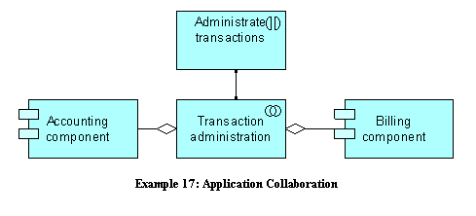
Application Collaboration(AC)
Là 2 hay nhiều app component hợp tác với nhau thực hiện những application interactions.
AC có thể assign với 1 hay nhiều app interaction hay 1 hay nhiều business interactions.
AC có thể đưa ra 1 hay nhiều interfaces và interface cũng có thể được used by bởi AC.

Slide 9
Application Interface:
Nó chỉ ra cách làm thế nào mà 1 app component kết nối với môi trường.
Phân loại:
+provide interface: thể hiện cái cách mà nó cung cấp function cho các component khác.
+require interface: thể hiện cái cách mà nó cung cấp chức năng ra bên ngoài.
+ be assigned to application services or business services
Notes:
an application interface specifies a kind of contract that a component realizing this interface must fulfill. This may include parameters, protocols used, pre- and post-conditions, and data formats.
An application interface can be assigned to application services or business services, which means that the interface exposes these services to the environment. The name of an application interface should preferably be a noun.

Slide 10
Data Object
Là những thông tin phù hợp cần cho quá trình xử lý.
Access bởi application fuction,application interaction,application service
Hiện thực 1 business object
Notes:
A data object can be accessed by an application function, application interaction, or application service. A data object may realize a business object, and may be realized by an artifact. A data object may have association, specialization, aggregation, or composition relationships with other data objects. The name of a data object should preferably be a noun.
Typical examples of data objects are a customer record, a client database, or an insurance claim.

Slide 11
Behavioral Concepts
External: application service
Internal: application function,application interact

Slide 12
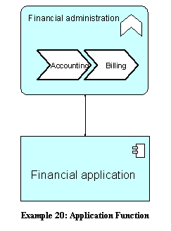
Internal
Application Function
Là một tập những internal behaviour của một component
Nó invisible với bên ngoài, và chỉ thông qua 1 HAY NHIỀU service
Sử dụng app service khác,hay infrastructure service khác
Notes:
Note that the internal behavior of a component should in most cases not be modeled in too much detail in an architectural description, because for the description of this behavior we may soon be confronted with detailed design issues.
An application function abstracts from the way it is implemented. Only the necessary behavior is specified.
An application function may realize application services.
Application services of other application functions and infrastructure services may be used by an application function. An application function may access data objects. An application component may be assigned to an application function (which means that the application component performs the application function). The name of an application function should preferably be a verb ending with “-ing”; e.g., “accounting”.

Slide 13
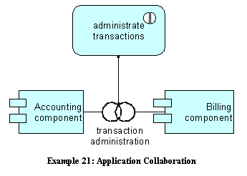
Application Interaction
Là một đơn vị ứng xử(behaviour) được thực hiện bởi sự kết hợp của 2 hay nhiều component.
external visible, assign bởi collaboration,reliaze service,access data object.

Slide 14
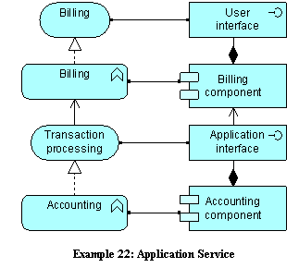
Application Service
Nó là một đơn vị của chức năng bên ngoài có thể nhìn thấy được,được cung cấp bởi 1 hay nhiều component thông qua interface cung cấp dịch vụ cho môi trường.
used by business processes, business functions, business interactions, or application functions.
Notes:
An application service exposes the functionality of components to their environment. This functionality is accessed through one or more application interfaces. An application service is realized by one or more application functions that are performed by the component. It may require, use, and produce data objects.
An application service should be meaningful from the point of view of the environment; it should provide a unit of functionality that is in itself useful to its users. It has a purpose, which states this utility to the environment. This means, for example, that if this environment includes business processes, application services should have business relevance.
A purpose may be associated with an application service. An application service may be used by business processes, business functions, business interactions, or application functions. An application function may realize an application service. An application interface may be assigned to an application service. An application service may access data objects. The name of an application service should preferably be a verb ending with ­“‑ing”; e.g., “transaction processing”. Also, a name explicitly containing the word “service” may be used.

